Slide 1
New England Wetland Functional Assessment

Slide 2
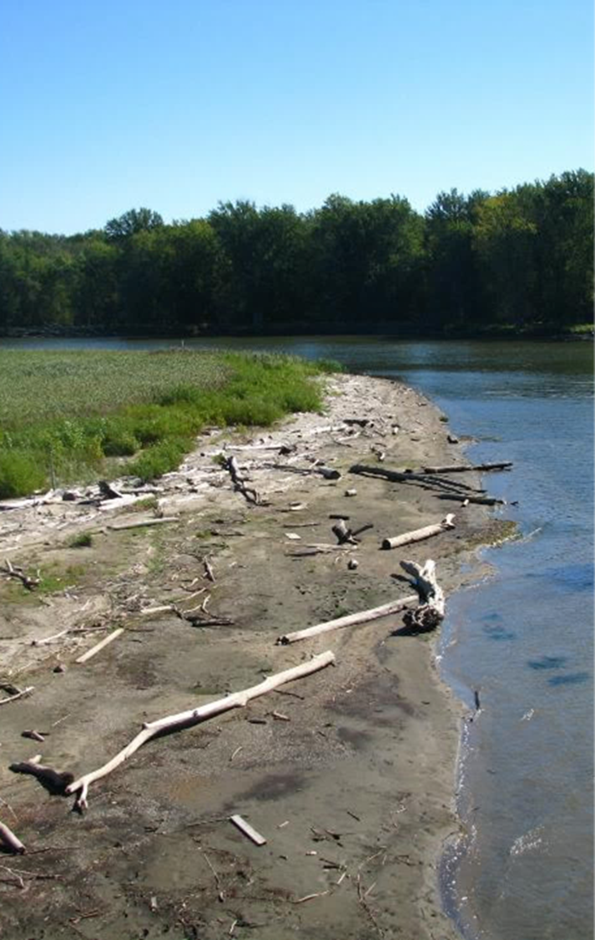
Goal: Quantitative Regional Functional Assessment Method
DESIGN OBJECTIVES:
Quantitative method for assessment of wetland function
Assess intrinsic capacity of a wetland to perform individual functions
Regional: consistent results in all six NE states
Rapid data collection: single site visit required
Cost-effective and user-friendly for trained individuals
Objective and repeatable results
Scientifically supported
Slight variations in input ≠ meaningful changes in output

Slide 3
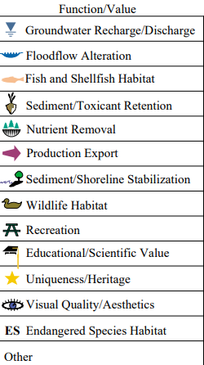
Highway Methodology: Functions & Services Assessed
8 Functions
5 Services

Slide 4
Quantitative vs. Qualitative
QUANTITATIVE – a method that involves some form of mathematical analysis of quantifiable data; e.g., number of pieces of coarse woody material along a specific length transect
RESULT = NUMERIC SCORE
QUALITATIVE – this incorporates a narrative approach to resource description; e.g., describing coarse woody material at a site as “moderate amounts of varying sizes”
RESULT = DESCRIPTION OR NARRATIVE

Slide 5
Function vs. Condition
FUNCTION = the normal activities or actions (e.g. the physical, chemical, and biological processes) that occur in a wetland ecosystem as a result of the characteristics of the wetland and the surrounding landscape
CONDITION = the health or level of degradation of a wetland ecosystem relative to a similar wetland without human alteration or other stressors (e.g. reference condition)

Slide 6
Model-Based Assessment
Functions are expressed by mathematical models where variables are combined in equations
Variables are based on measurable data – remote and/or field-collected
Variables are scored based on the specific data collected
Models determine functional capacity score
Models are typically scored on a scale, e.g., 0.0 to 1.0, 0-10, 1-100, etc.

Slide 7
Development Process
2013: Convene and review existing methods, Draft method and models developed
2015: Preliminary interagency field testing, Analyzed results and revised models
2017: Second season of field testing, collected soil and water samples for analysis at EPA Lab
2019: Third field season, focus on coastal sites; analyze results, calibrate models,
2021-2024: finalize method, write user guide, public notice for comments and testing

Slide 8
NEWFA IN A NUTSHELL
Assesses Intrinsic Function
3 Categories
(14 Functions)
Water Quality Maintenance
Hydrologic Integrity
Biota Support
Specific to New England
Applies to all HGM sub-types
Model is only used if function is applicable
Quantitative Output
Variable scores are function specific
Model calculates Functional Capacity Grade (FCG)

Slide 9
Functions Defined (Water Quality)
PARTICULATE RETENTION – the ability of the wetland to stop and retain sediment, reducing dissolved and suspended solids
REMOVAL AND SEQUESTRATION OF HEAVY METALS –the ability of the wetland to bind heavy metals and retain them in place (usually bound to soil particles), thereby removing them from the water column
PHOSPHORUS RETENTION - the ability of the wetland to remove and bind excess nutrient phosphorus from the water column
NITROGEN TRANSFORMATION - the ability of the wetland to remove and transform excess nutrient nitrogen from the water column
CARBON SEQUESTRATION - the ability of the wetland to capture and store atmospheric carbon dioxide

Slide 10
Functions Defined (Hydrology)
GROUNDWATER RECHARGE – the ability of the wetland to facilitate the movement of surface water into the groundwater system
SURFACE WATER DETENTION – the ability of the wetland to slow and detain surface water flows
STREAMFLOW MAINTENANCE – the ability of the wetland to provide groundwater discharge at the headwaters of one of more streams, thus maintaining base flow in periods of low precipitation
COASTAL STORM SURGE REDUCTION – the ability of the wetland to hold and absorb coastal (all tidally-influenced waters or Lake Champlain) storm surge within the wetland
BANK STABILIZATION – the ability of the wetland to stabilize and protect streambanks from erosion
SHORELINE STABILIZATION – the ability of the wetland to stabilize and protect against shoreline erosion

Slide 11
Functions Defined (Biota Support)
PRODUCTION EXPORT – the ability of the wetland to produce and transport food for other living organisms (including humans)
PLANT COMMUNITY INTEGRITY – the ability of the wetland to maintain a healthy, native plant community typical of the regional geomorphic and climatic condition
WILDLIFE HABITAT INTEGRITY – the ability of the wetland to maintain a healthy, native faunal community typical of the regional geomorphic, vegetative and climatic condition

Slide 12
Functions Assessed
WATER QUALITY MAINTENANCE | HYDROLOGY | BIOTA SUPPORT
(1) Particulate Retention | (6) Groundwater Recharge | (12) Production Export
(2) Removal & Sequestration of Heavy Metals | (7) Surface Water Detention | (13) Plant Community Integrity
(3) Phosphorus Retention | (8) Streamflow Maintenance | (14) Wildlife Habitat Integrity
(4) Nitrogen Transformation | (9) Coastal Storm Surge Reduction
(5) Carbon Sequestration | (10) Bank Stabilization
 | (11) Shoreline Stabilization
RESOURCE SPECIFIC FUNCTIONS

Slide 13
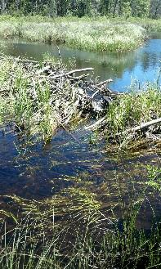
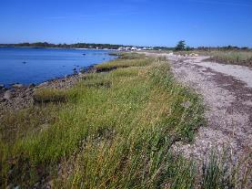
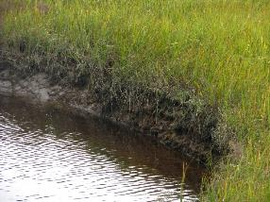
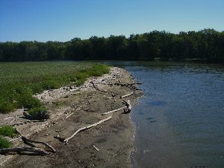
Resource Specific Functions
FCG is only calculated if the resource is present
Streamflow Maintenance
Coastal Storm Reduction
Bank Stabilization
Shoreline Stabilization

Slide 14
Data Collection
Input
Identify Assessment Area
Plan Site Visit
Determine Sampling Locations
Desktop
PHYSICAL (Hydrology)
CHEMICAL (Biogeochemical)
Site Visit
Soil/Substrate
Vegetation
Hydrology
Field Data
BIOLOGICAL (Habitat)
SURROUNDING LANDSCAPE
GIS Analysis
Surrounding Landscape
Desktop

Slide 15
NEWFA Variables and Scoring
Data (field or desktop) collected determines score for variables
Most Variables scored from 1-10
Scoring can be a range or binary (presence/absence)
Some variables are used in multiple models
Example: Landscape Position is used in four different models
Particulate Retention
Groundwater Recharge
Surface Water Detention
Groundwater Discharge
Scoring is specific to each model

Slide 16
Model Output
Functional Capacity Grades (FCG) range from 1-10
Each function is graded separately
FCG determines functional category
Wetland
DOES NOT receive a total functional grade
N/A | Function not applicable
1 to 3 | Low functioning
4 to 6 | Moderate functioning
7 to 10 | High functioning

Slide 17
Models

Slide 18
Questions?
For more information contact:
Paul.Minkin@usace.army.mil
Or
Sachs.Erica@epa.gov

